Slide 1

IMPACT OF THE US RECESSION ON THE INDIAN ECONOMY
PRESENTERS:
A001, Durva VIKAS Agarwadkar
A007, JINAV DHIREN GALA
A010, MAITREE KATIYAR
A012, SHAIVEE KATIYAR
MENTORED BY:
DR. DEBASMITA MUKHERJEE

Slide 2
AGENDA
PHASE 1
DATASET DESCRIPTION
MODELS USED
PHASE 2
PHASE 04
FITTING OF REGRESSION MODEL
EDA GRAPHS
SELECTION OF THE BEST MODEL
INFERENCES
PHASE 03

Slide 3
PHASE I

Slide 4

DATASET DESCRIPTION
1. This Dataset is fetched from Federal Reserve Economic Data | FRED | St. Louis Fed and is seasonally differenced.
2. It has 252 records.
3. The records are dated from 1960-2022.
4. It is a Quarterly dataset.

Slide 5
VARIABLES USED
Gross Domestic Product (GDP) Growth Rate
Total Manufacturing Production (TMP)
Real Effective Exchange Rate (REER)
Unemployment Rate (UR)
M3 Money Supply (M3)
Total Unit Labour Cost: Manufacturing (TULCM)
Consumer Price Index (CPI)
Total Share Prices (TSP)
Total Construction Production (TC)

Slide 6
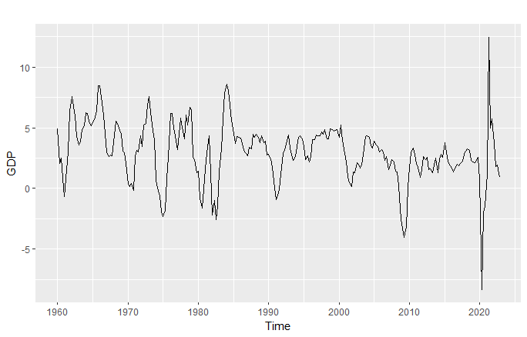
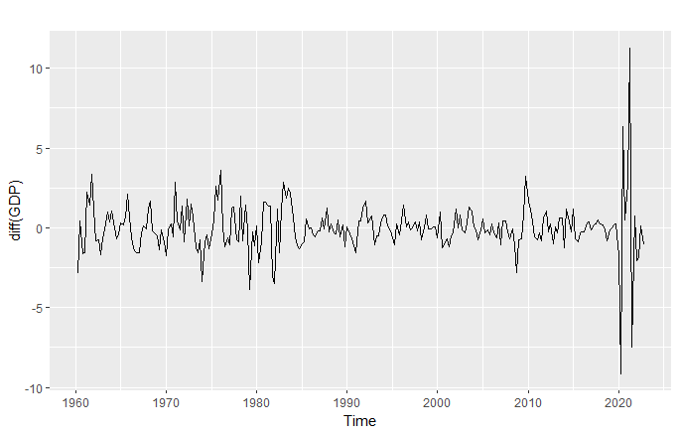
GRAPHS

Slide 7
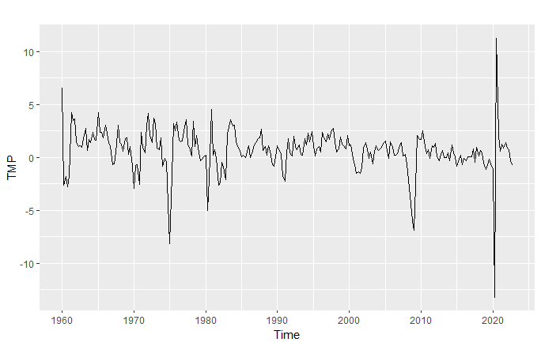
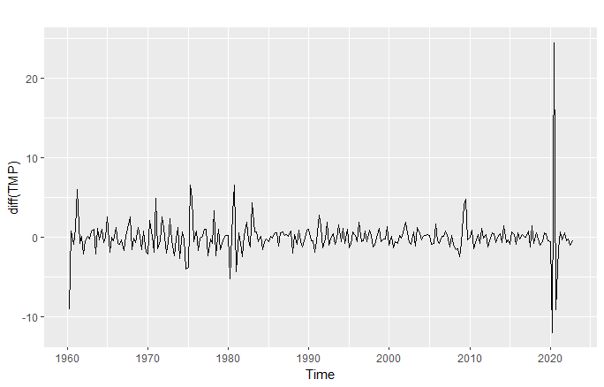
GRAPHS

Slide 8
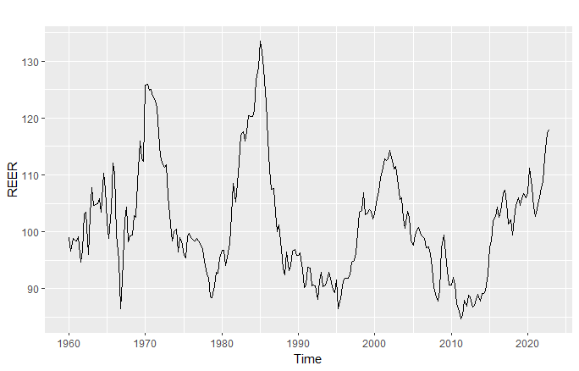
GRAPHS

Slide 9
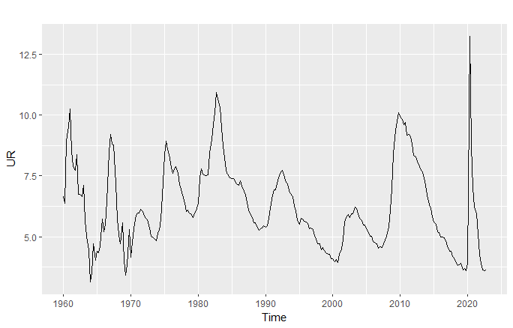
GRAPHS

Slide 10
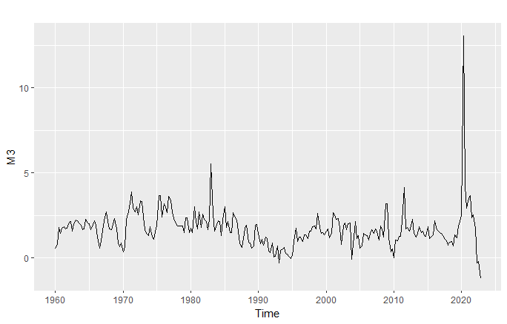
GRAPHS

Slide 11
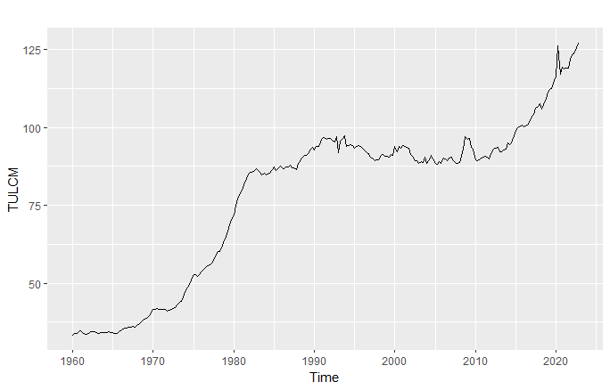
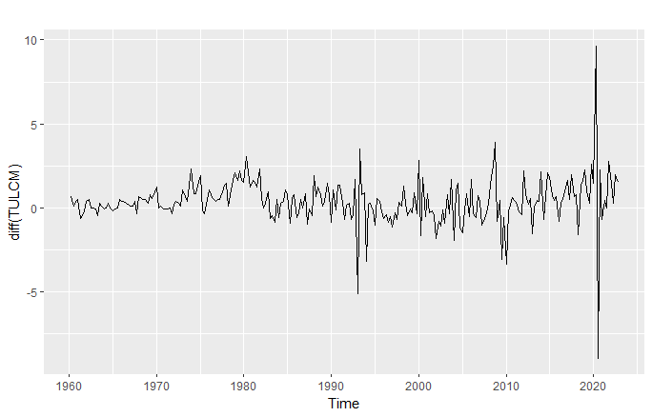
GRAPHS

Slide 12
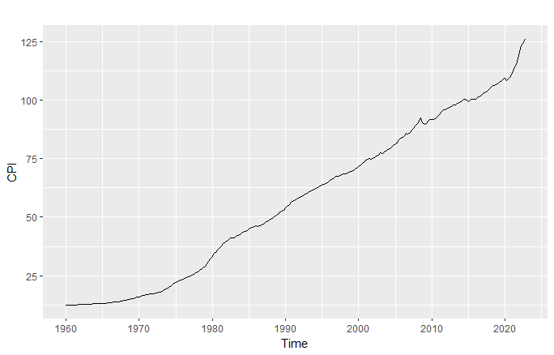
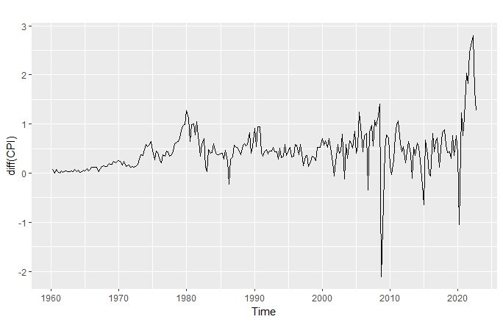
GRAPHS

Slide 13
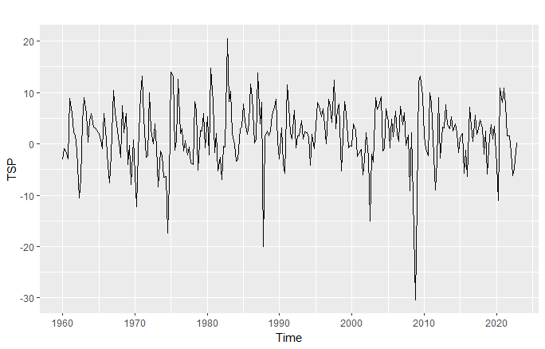
GRAPHS

Slide 14
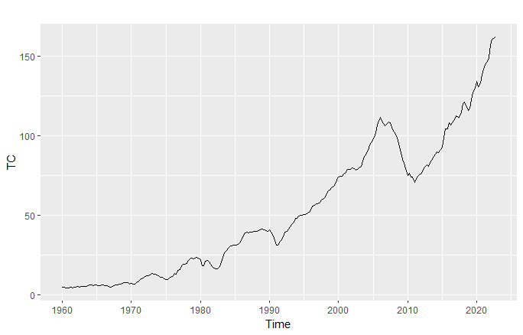
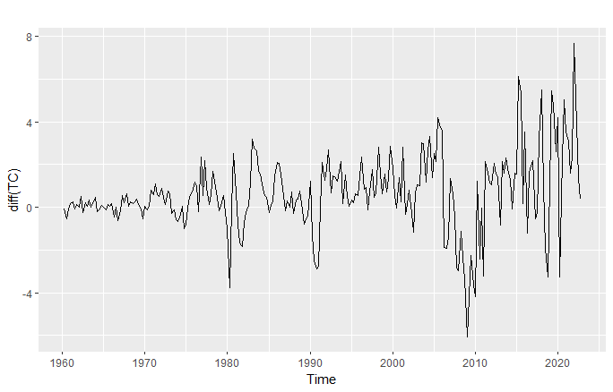
GRAPHS

Slide 15
PHASE II

Slide 16
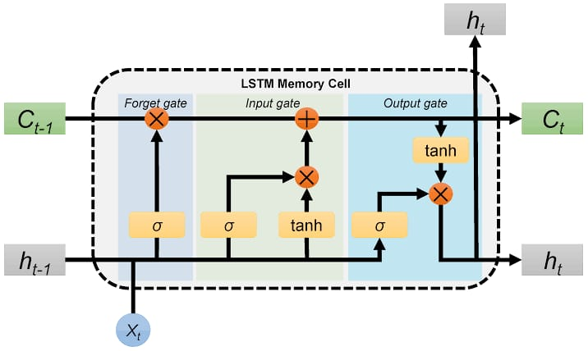
LSTM (Long Short Term Memory)

Slide 17
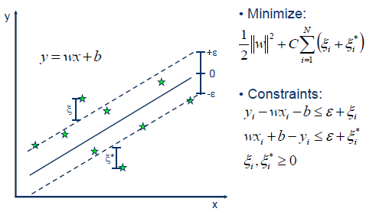
Support vector REGRESSOR (svR)

Slide 18
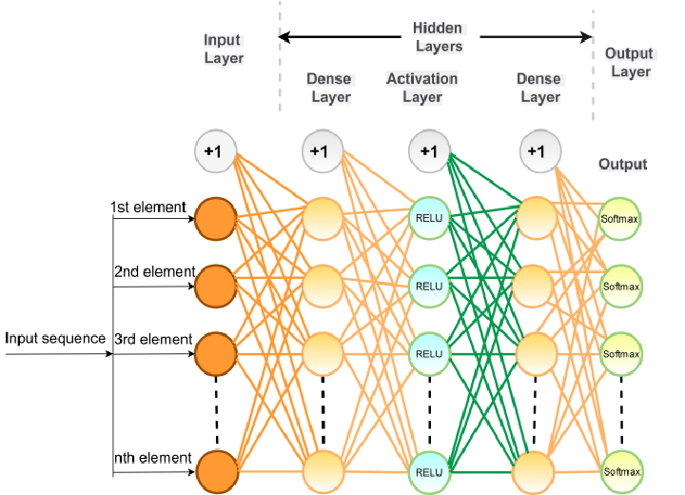
Multilayer perceptron model (mlp)

Slide 19
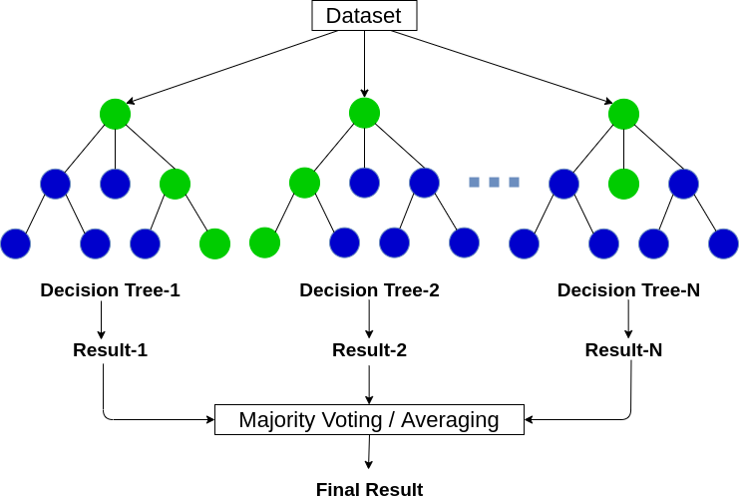
RANDOM FOREST REGRESSOR

Slide 20
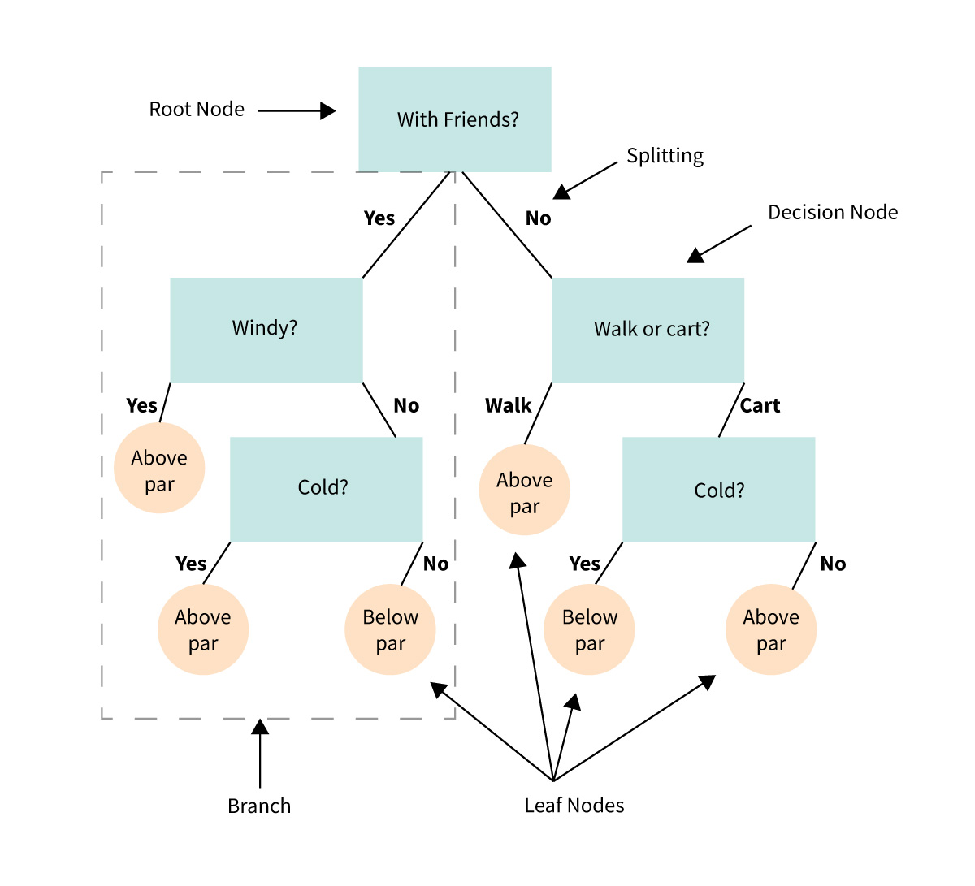
DECISION TREE REGRESSOR

Slide 21
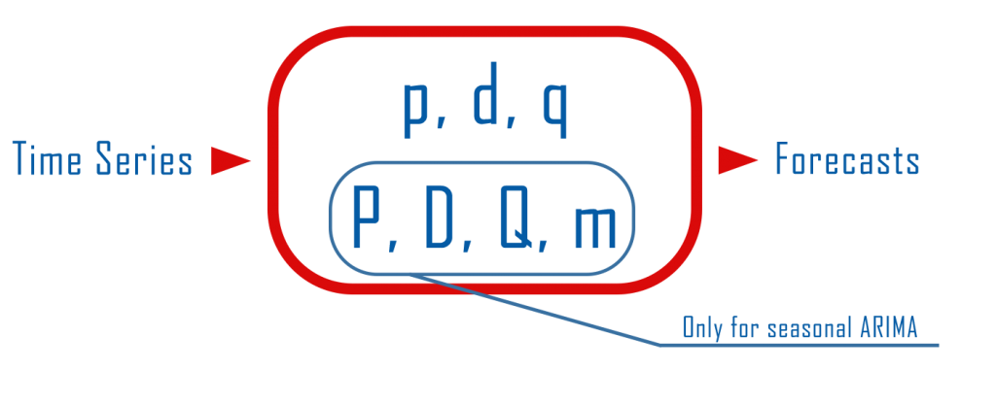
(S)ARIMA

Slide 22
PHASE III

Slide 23
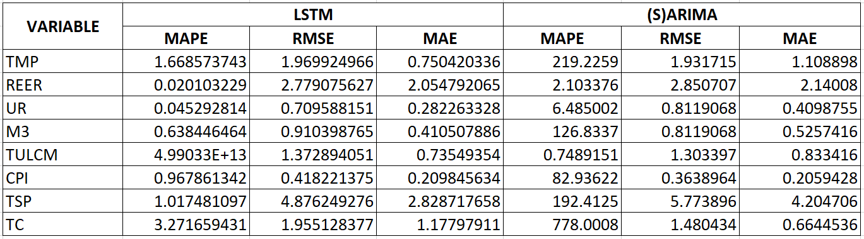
MODEL SELECTION
EXOGENOUS VARIABLES

Slide 24
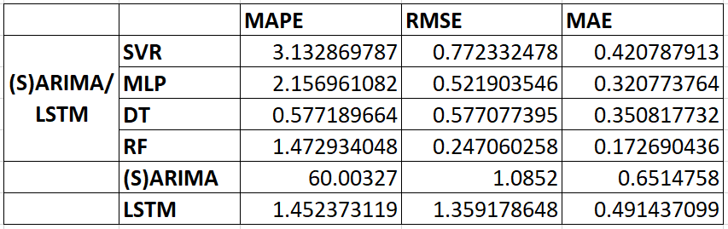
MODEL SELECTION
TARGET VARIABLE – US GDP

Slide 25
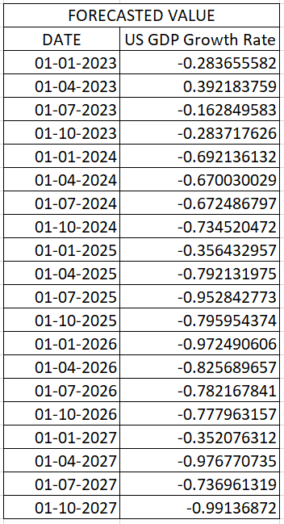
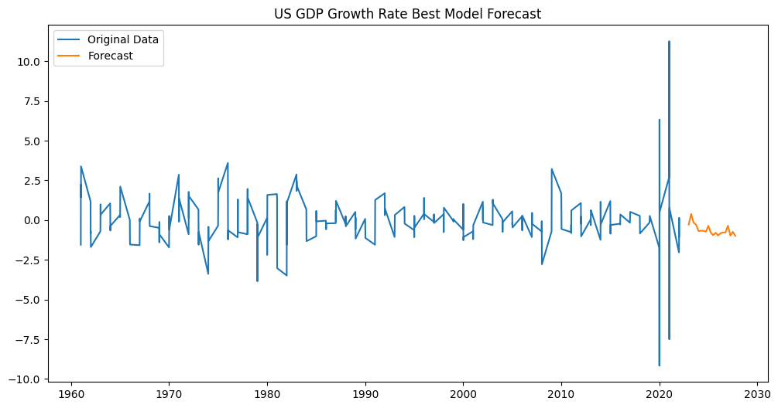
MODEL SELECTION
US Gdp FORECAST -- RF

Slide 26
PHASE IV

Slide 27
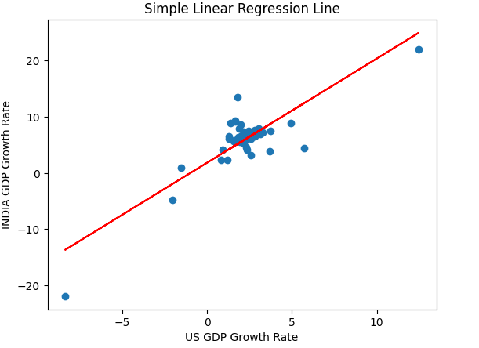


REGRESSION

Slide 28
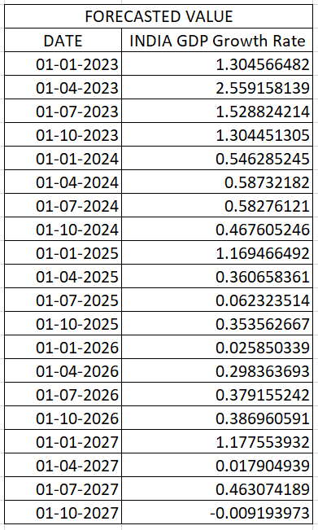
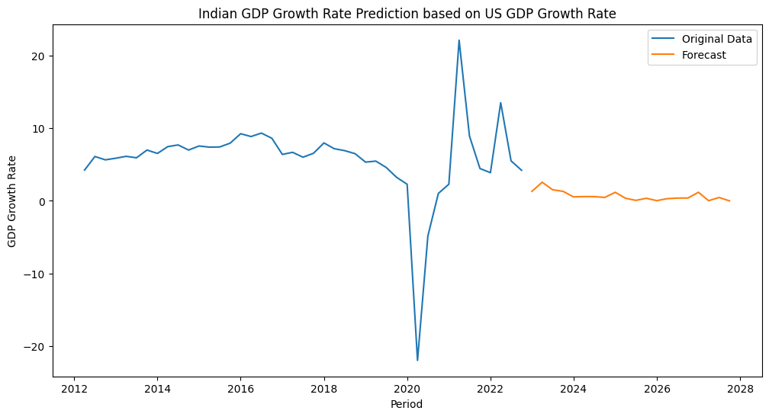
PREDICTION
inDIA’S GDP

Slide 29
INFERENCES
With 1% increase in the growth rate of the US Economy, there will be around 3-4% increase in the growth rate of the Indian Economy.
With 1% decrease in the growth rate of the US Economy, there will be around 0.02% decrease in the growth rate of the Indian Economy.

Slide 30
CONCLUSION
Considering the current US Recession;
It can be concluded that the US Economy does have an impact on the Indian Economy.
However; with reference to the figures, the impact is not significant enough for India to have recession anytime soon.

Slide 31
THANK YOU

